Slide 1
Analysis of collisions and police incidents
Rohin Garg
Data 205

Slide 2
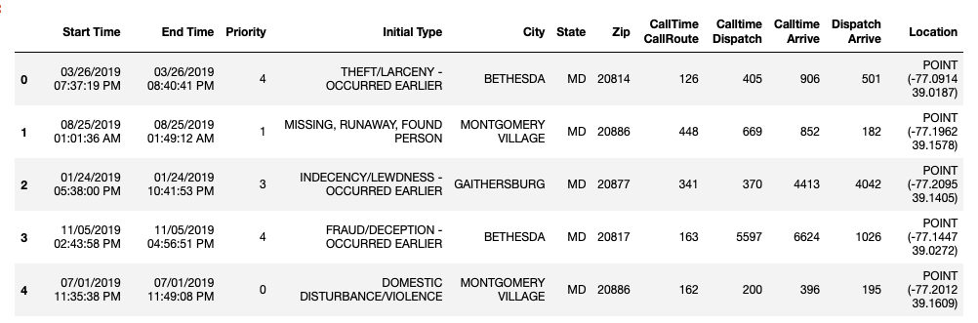
Police dispatched incidents
Imported from DataMontgomery
Contains a list of Police Dispatched Incidents records
Updated 4 times daily
805K Rows, 26 Columns

Slide 3
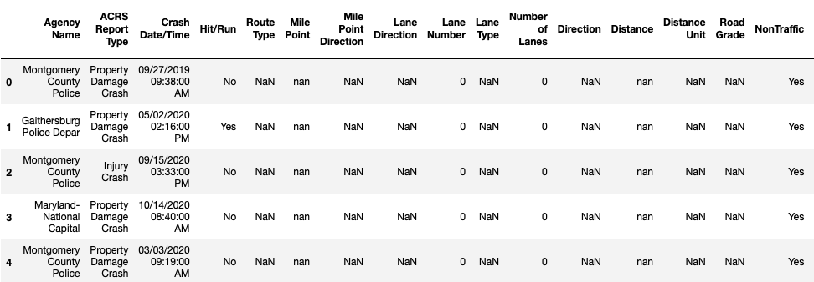
Crash reporting – incidents dataset
Imported from DataMontgomery
Provides general information about each collision and details of all traffic collisions occurring on county and local roadways within Montgomery County
Updated Weekly
67.8K Rows, 44 Columns
A lot of missing values

Slide 4
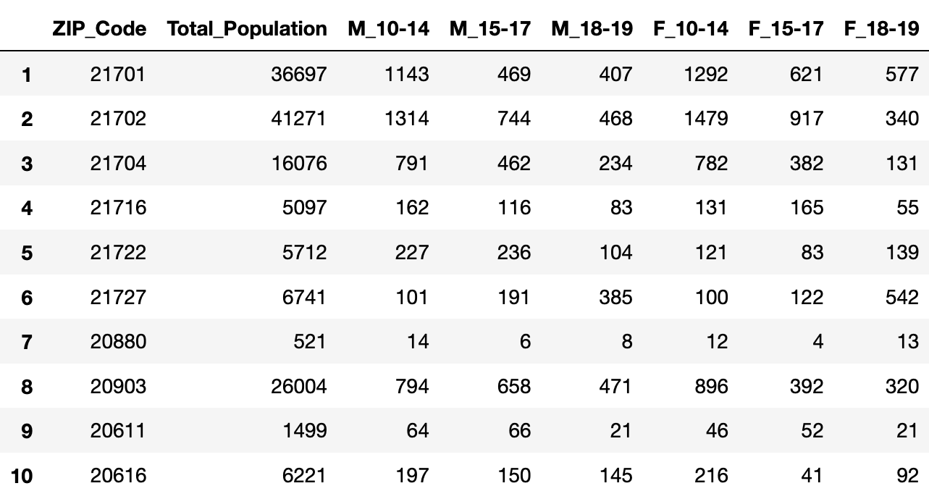
Census data
Imported dataset showing variables pertaining to each ZIP Code in MD
Variables of interest:
ZIP Code
Total Population
Variables showing the number of children at certain age ranges

Slide 5
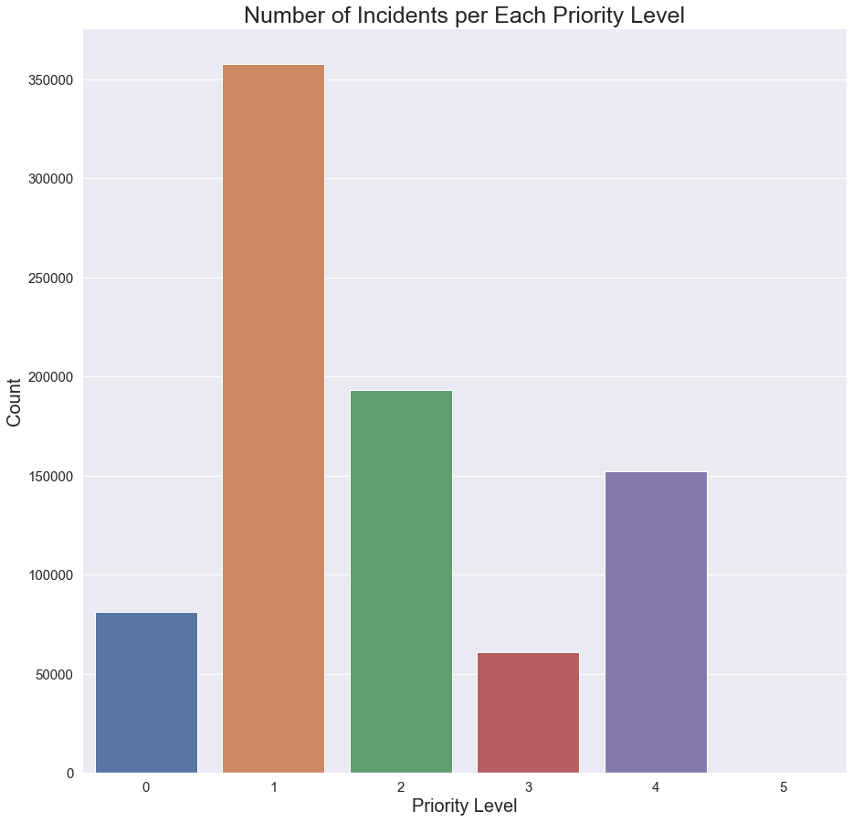
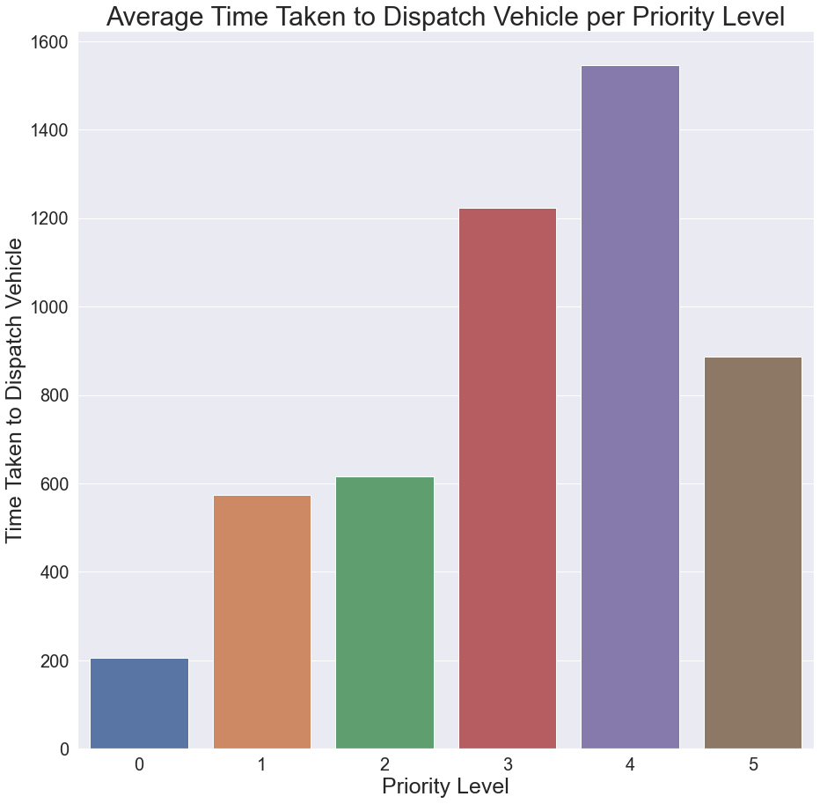
How often are incidents classified as a certain priority level and how does the priority level affect dispatch time?
NOTE: Smallest priority level means a higher priority
Priority Level 0 is the highest priority
Priority Level 5 is the lowest priority
The highest number of incidents are classified as Priority Level 1
The higher the priority, the quicker a police officer is dispatched.
Priority Level 5 contained very little incidents which skewed the data for that level.

Slide 6
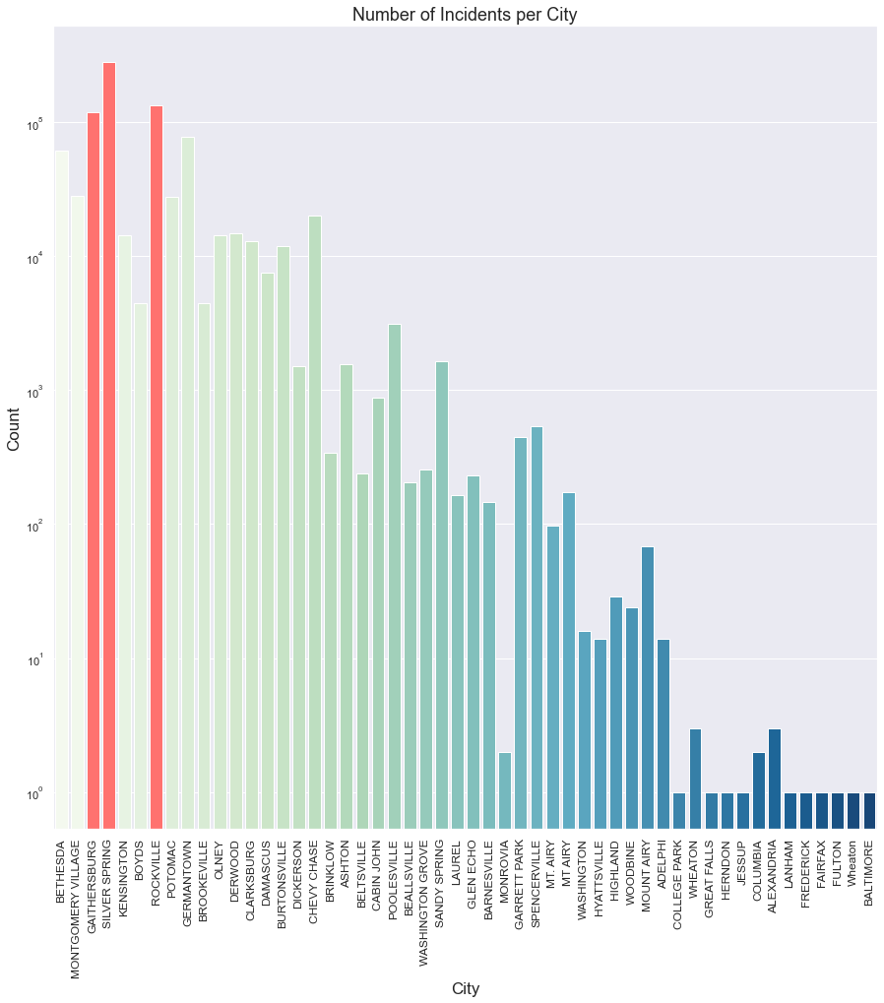
Which cities have the most incidents?
Y – Axis is using logarithmic scaling
Most common cities with incidents
Silver Spring (Highlighted)
Rockville (Highlighted)
Gaithersburg (Highlighted
Germantown
Bethesda

Slide 7
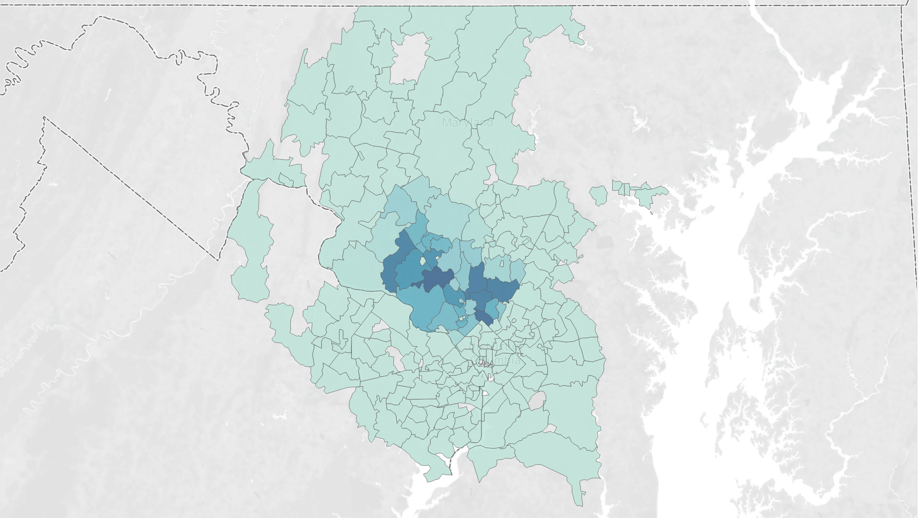
Map of incidents per zip code

Slide 8
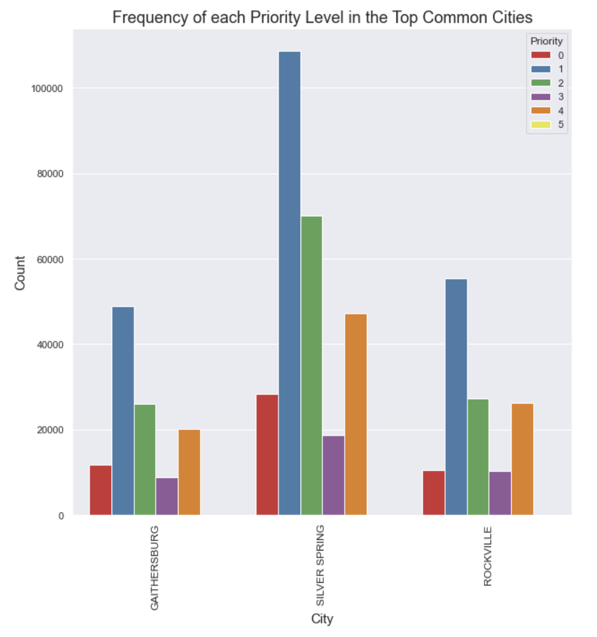
In the 3 common cities, what are the frequencies of each priority level?
Calculating the frequencies of each priority level for the three most common cities

Slide 9
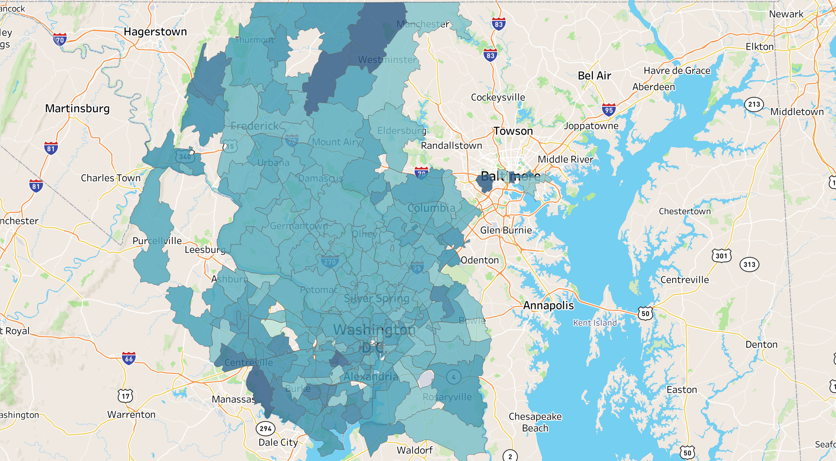
Map of average priority level per zip code

Slide 10
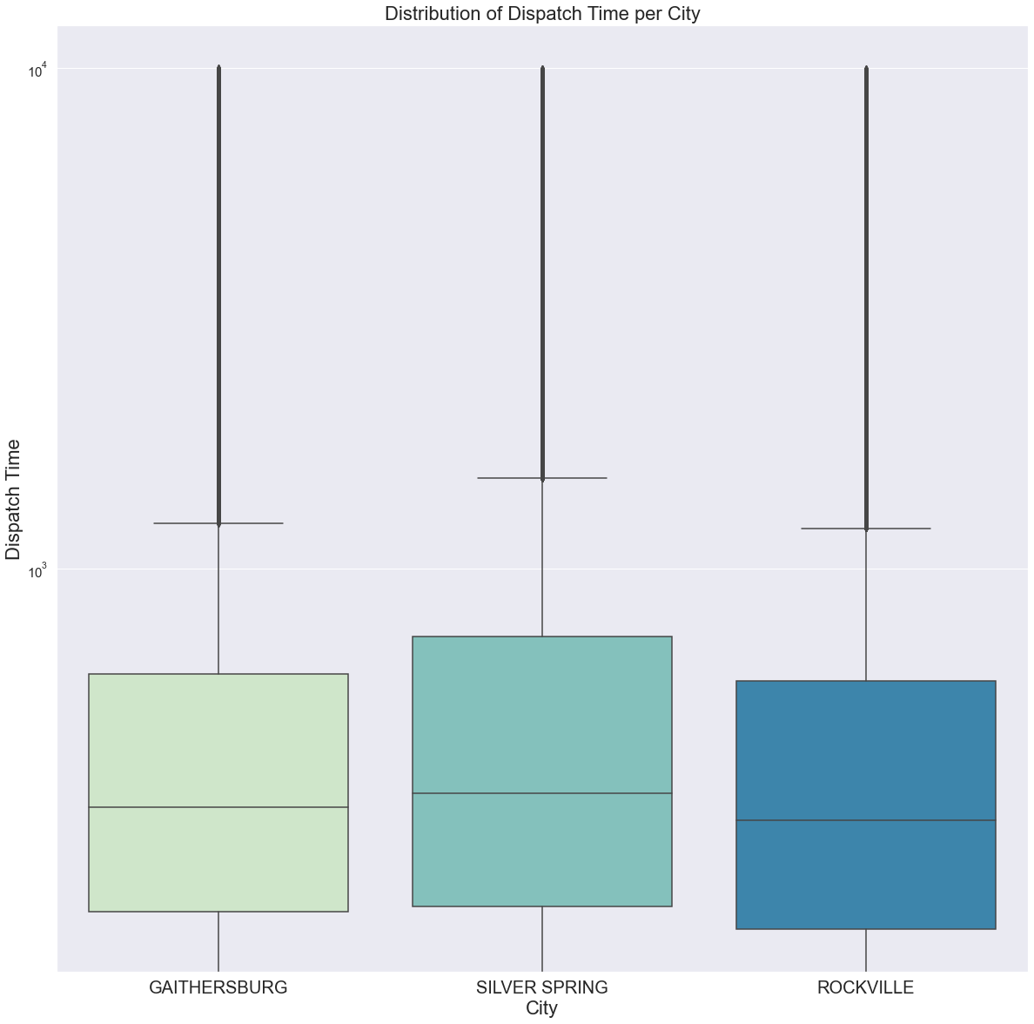
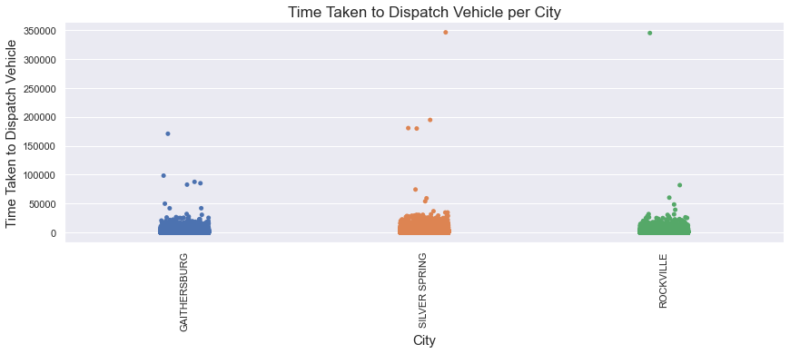
What is the distribution of dispatch time for the cities with the highest number of incidents?
Highest Dispatch Times
1. Silver Spring
2. Gaithersburg
3. Rockville
Conducted Chi-squares test to determine if there was a statistically significant difference between the dispatch times.
P– Value was < 0.05, therefore if you live in Gaithersburg or Rockville, you are more likely to experience lower dispatch times.

Slide 11
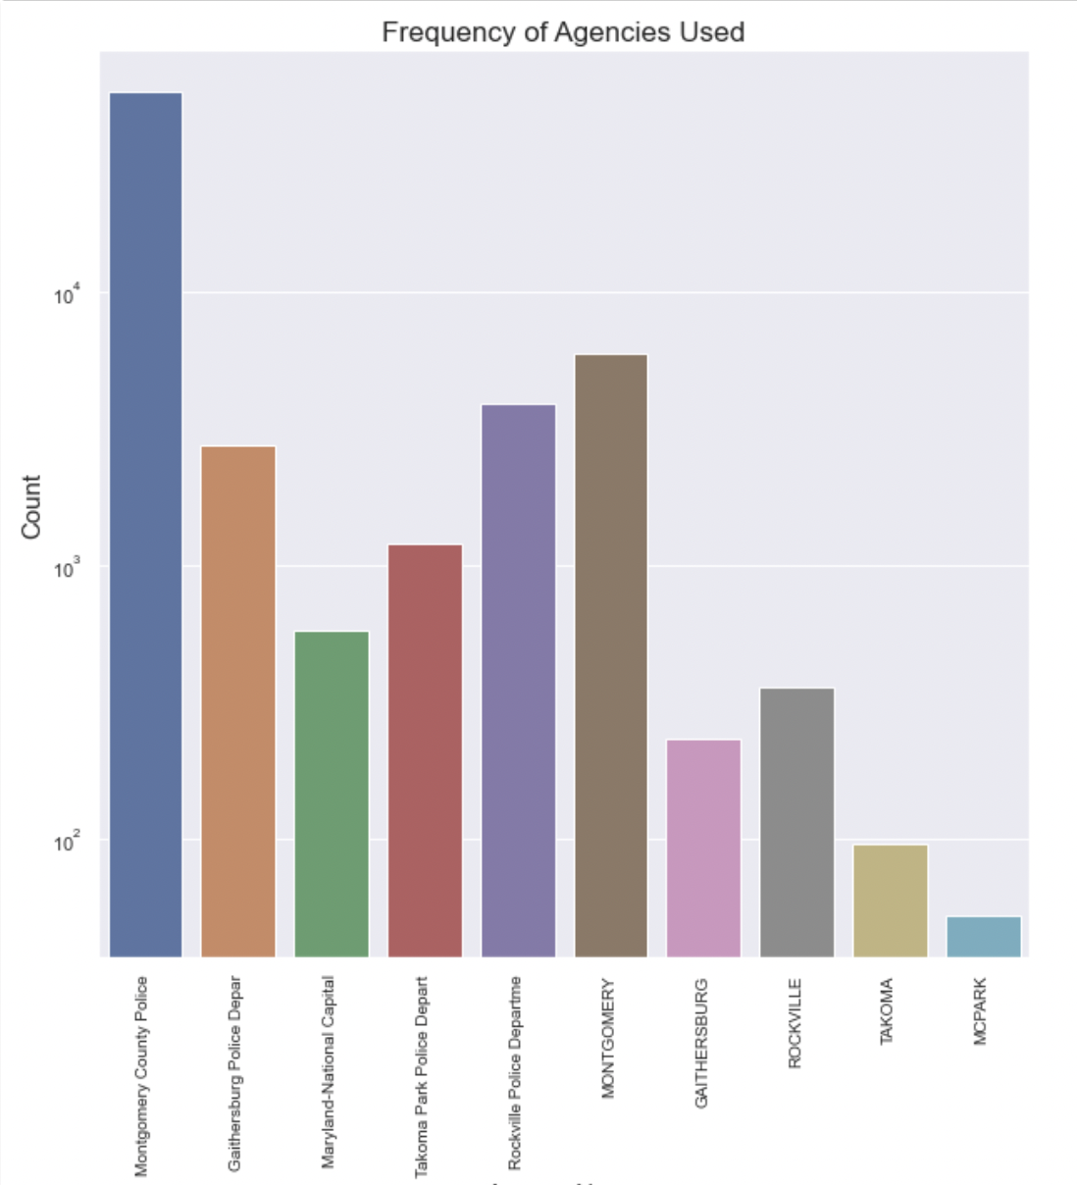
What are the most frequent agencies used?
Y – Axis is using logarithmic scaling
Most frequent agencies used
Montgomery County Police
Rockville Police Department
Gaithersburg Police Department
Takoma Park Police Department

Slide 12
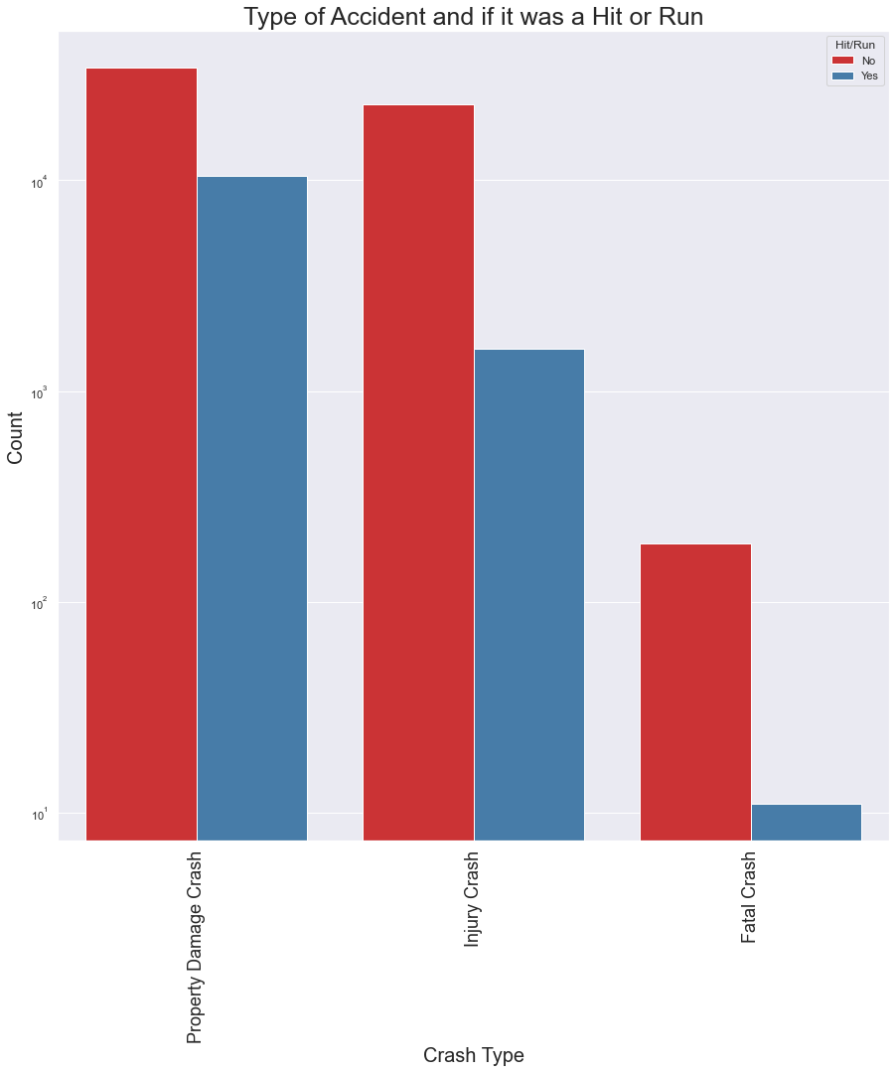
How common is a hit and run?
Shows the frequency of Hit & Runs for each type of incident
Property Damage Crash
Injury Crash
Fatal Crash
Y – Axis is logarithmically scaled.

Slide 13
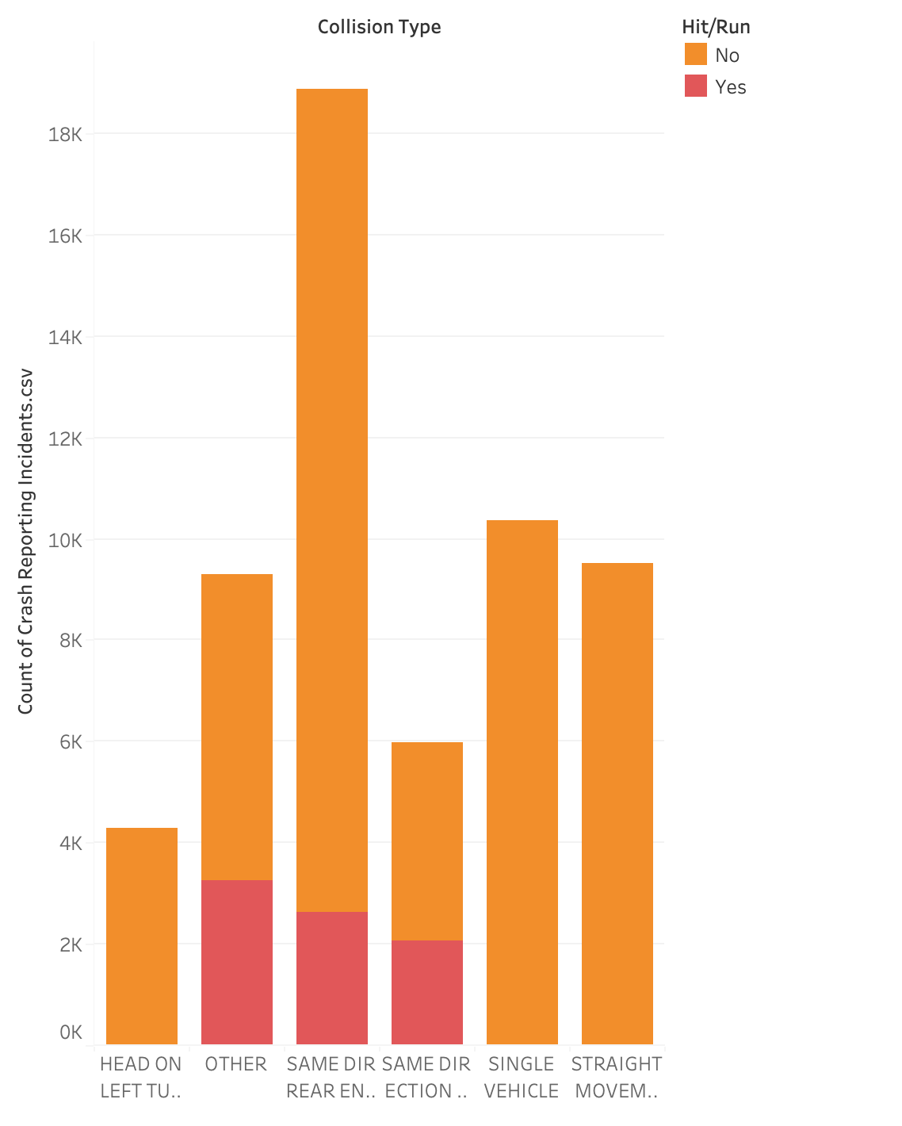
Which types of collisions most results in a hit and run?

Slide 14
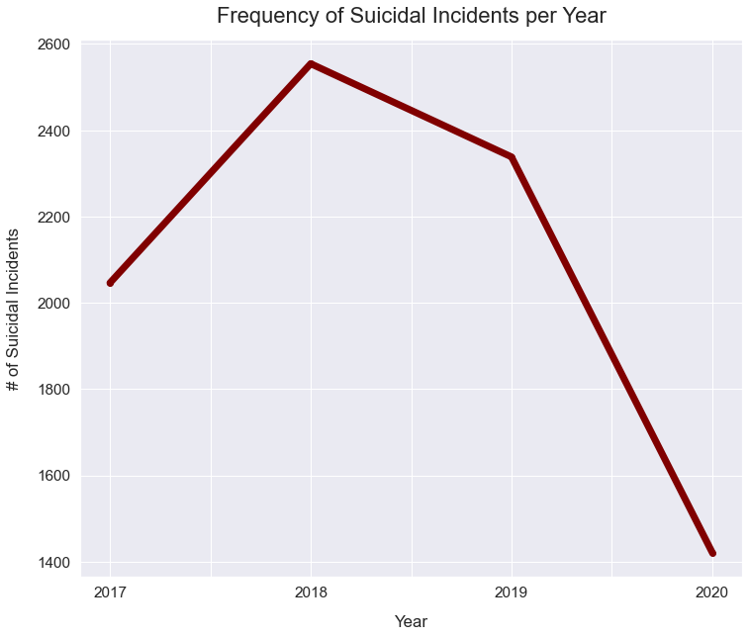
How has the frequency of suicidal incidents changed from 2017-2020?

Slide 15
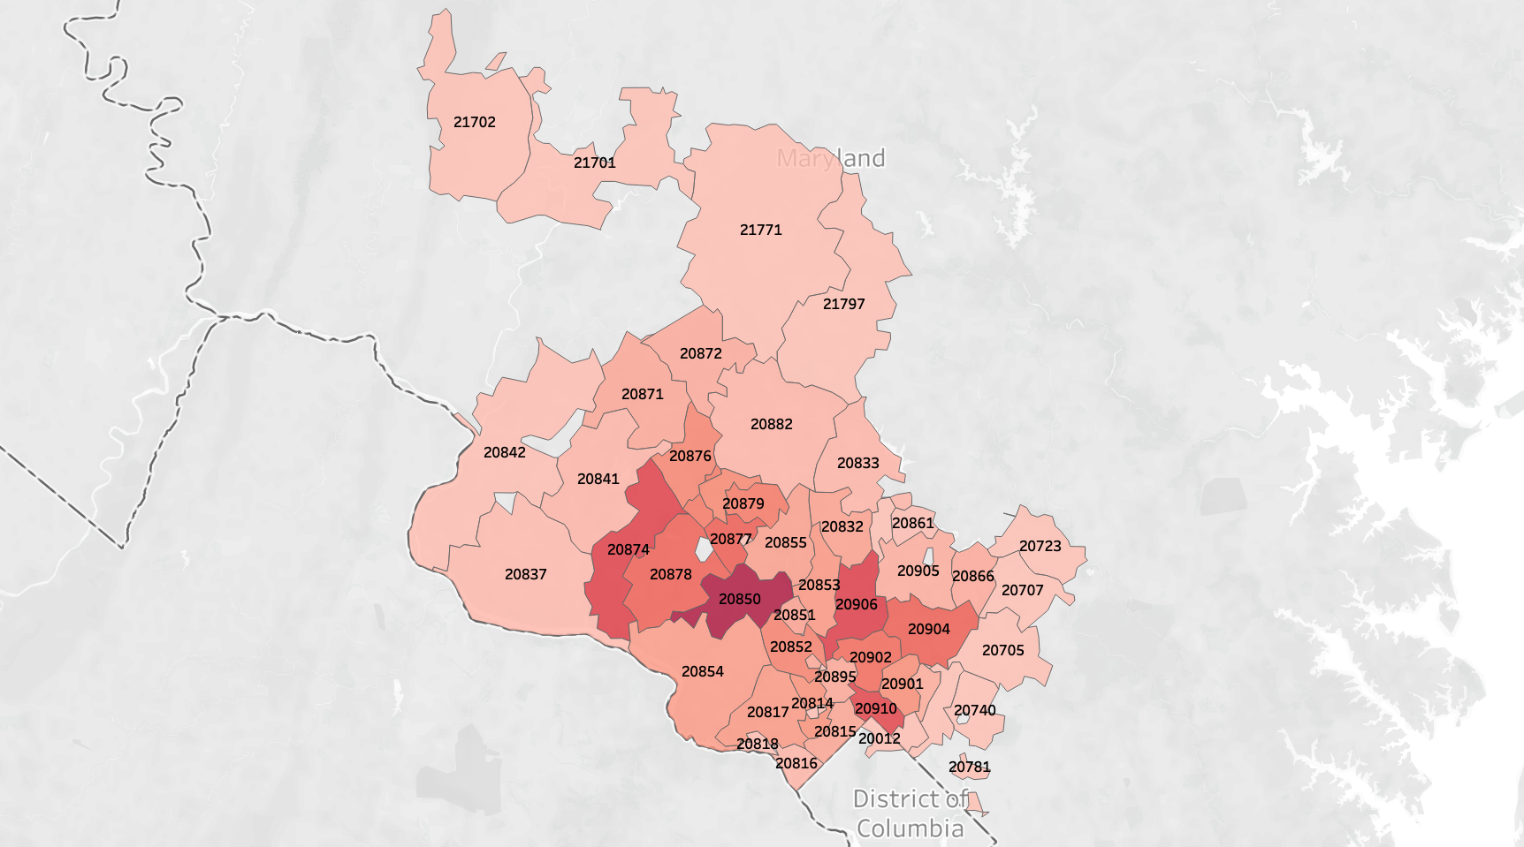
Map of suicidal incidents per zip code

Slide 16
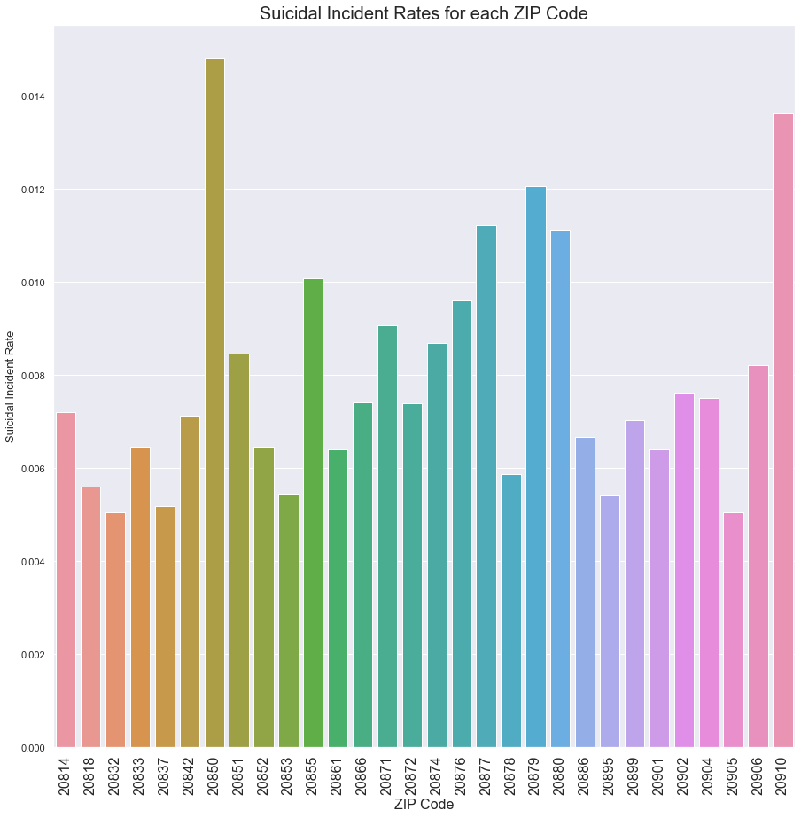
Which zip codes have the highest rate of suicidal incidents
Shows the suicidal incident rate for each ZIP Code.
1 – 20850
Located in Rockville
2 – 20910
Located in Silver Spring and Takoma Park

Slide 17
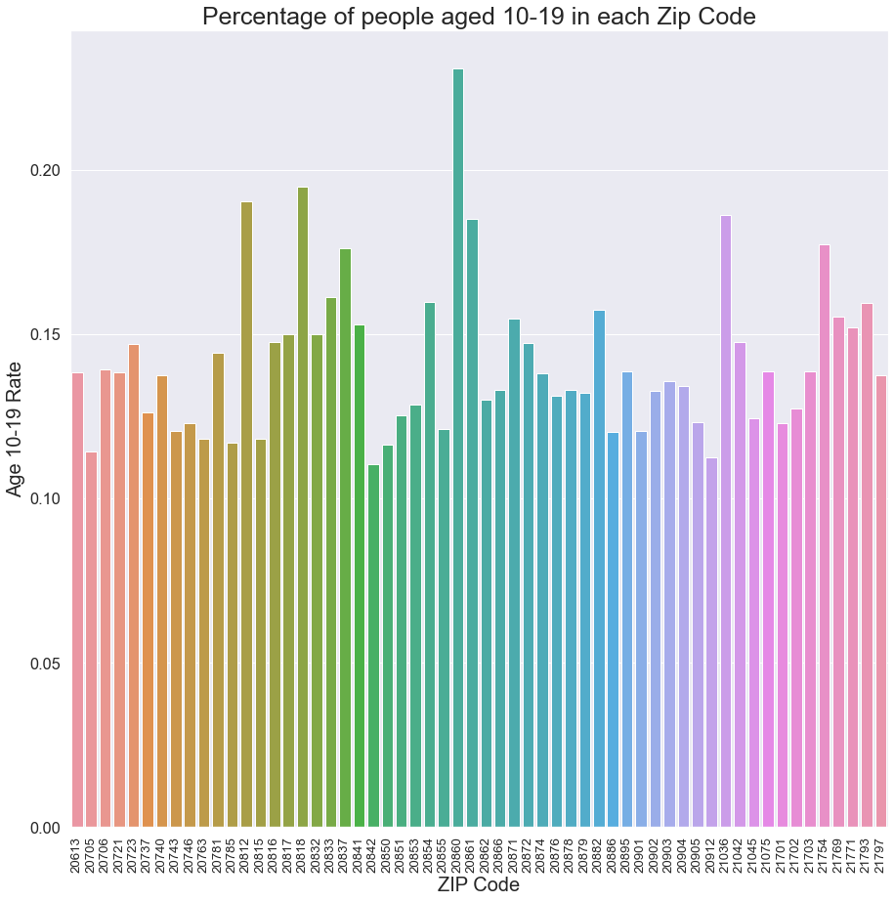
Which ZIP Codes have the highest rate of children aged from 10-19?

Slide 18
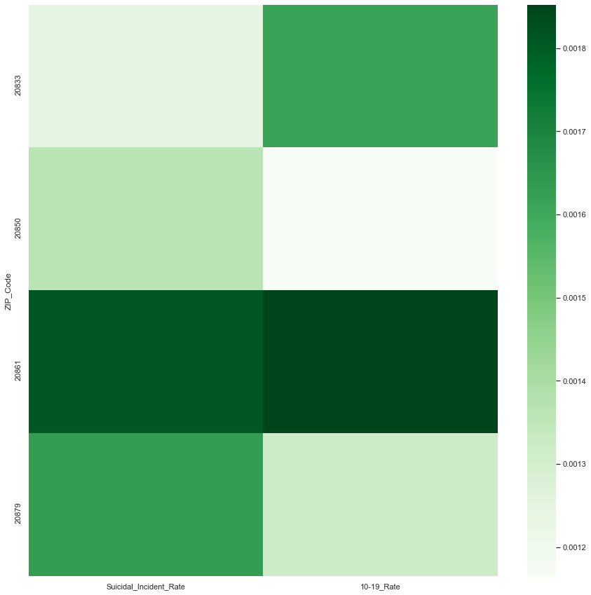
Heatmap depicting the relationship between the suicidal incident rate and children aged 10-19 rate in 5 common zip codes

Slide 19
Recommendations to strengthen datasets
I would recommend for the Police Dispatched Incidents data to add variables regarding the victim of the incident. Therefore, one could create more inferences from the incidents. In my case, I would’ve used the ages of the victims in the suicidal incidents to investigate deeper on whether children specifically have a higher rate of suicidal incidents.
Add a note explaining that a lower Priority Level means that the actual priority is higher. I was confused about this and had it backwards for the first couple weeks working on the project.
For the “Crash Reporting Incidents” dataset, I would recommend to add a column depicting the type of vehicle or vehicles involved in the collision. Therefore, one can analyze if certain car models or car brands have a higher rate of collision over a period of time.

Slide 20
Thank you so much to…
The Montgomery County Government
Victoria Lewis
dataMontgomery
Professor Iapalucci
Professor Saidi
Professor Mohammed
Fellow Students
for your support and direction throughout this program!

